Slide 1


Team 1
RESTAURANT WEBSITE
Presented by -
C. Surya Teja
K. Akash
K. Santoshi
R. Hariom
Y. Navya Sahithi

Slide 2

AGENDA
Objective
Problem Statement
Technologies Used / Component Used
Flow Diagram of work
Future Enhancement
Output Screenshot

Slide 3
OBJECTIVE
The Eat Club restaurant website project is to create an online platform that effectively represents and promotes. The restaurant's brand, offerings, and services.

Slide 4

PROBLEM STATEMENT
Eat Club restaurant requires a fully functional website that represents its brand and provides an interactive platform for customers.
The website should have a responsive design to ensure accessibility on various devices and be visually appealing to attract potential customers.

Slide 5


TECHNOLOGIES USED / COMPONENT USED

Slide 6
FLOW DIAGRAM
Home
Reservation
About
Veg
Contact
Menu
Non-veg
Select Food
Our Team
Deserts
Future Scope
Place Order
End
Payment

Slide 7
Future Enhancement
Online Deliveries.
Add-to-cart.
Payment methods.
Offers and Discounts.
Database.
Search bar.
Rating to foods.

Slide 8
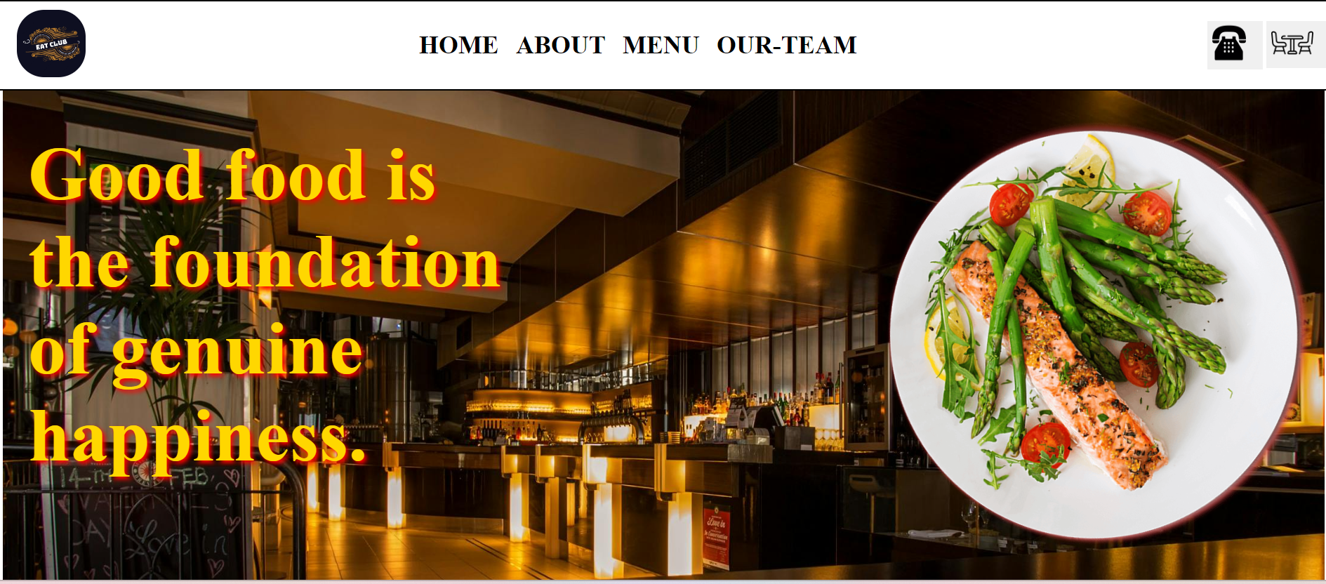

OUTPUT SCREENSHOT

Slide 9
THANK YOU

